Slide 1

Finding Transformer Circuits with Edge Pruning (NeuRIPS 2024)
By: Group 4

Slide 2
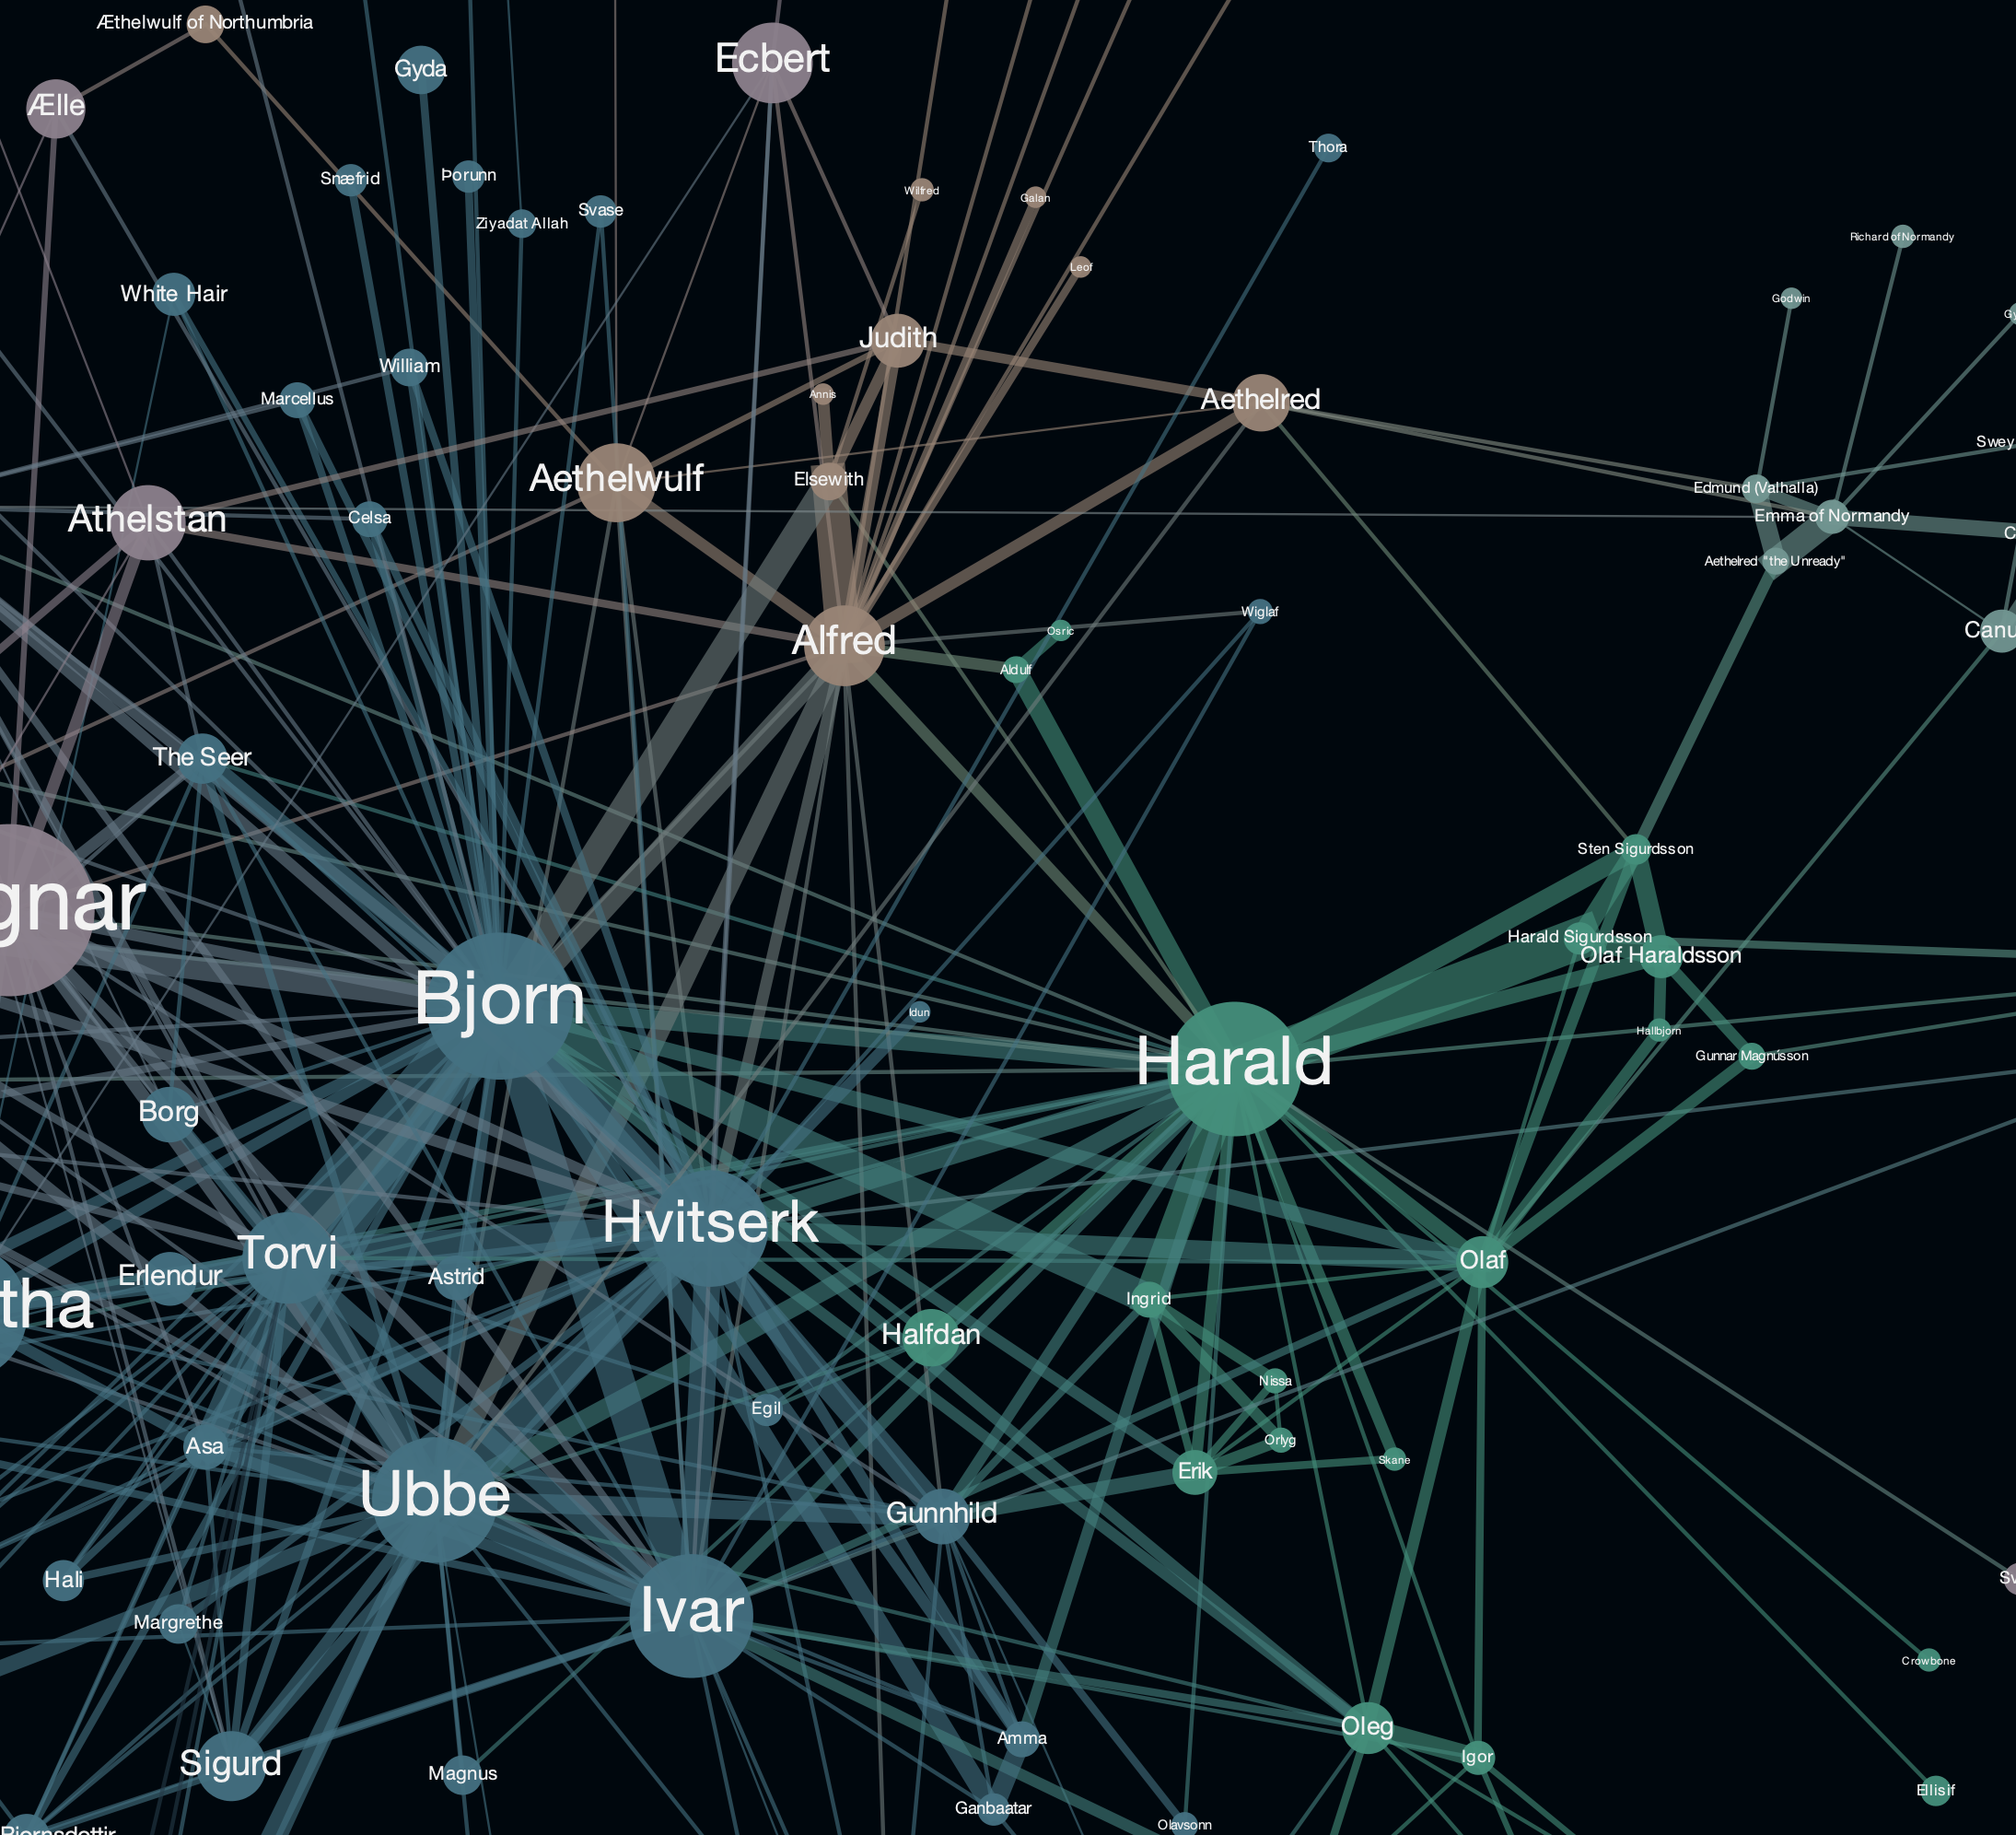
Pitfalls of Other Methods

Slide 3

High Level Overview of Our Method

Slide 4

Working of Masking System

Slide 5

Lagrangian Sparsity Enforcement

Slide 6

Loss Function

Slide 7

Code Walkthrough

Slide 8
Team
Aryan Lohia 23MA10073
Antariksh Das 23CS10086
Siddhant Singh 23CS10085

Slide 9


